Slide 1

3D OBJECTION RECOGNITION using Yolo
Presented by
245621733017 G DEDEEPYA
245621733032 MNS NIKHITHA
245621733053 S BHAVANA
Name of the Guide:
Mrs. J Siva Naga Jyothi

Slide 2

Abstract
3D object recognition using YOLO builds on the model's well-established 2D detection capabilities by integrating depth data obtained from advanced sensors such as LiDAR or stereo cameras. This process requires the transformation of 3D information into formats like point clouds , voxel grids, or multi-view 2D projections, which the model can interpret. To achieve accurate 3Dobject recognition, YOLO is adapted to not only detect objects but also to generate 3D bounding boxes, enabling precise localization within a three-dimensional space. This approach allows YOLO to maintain its hallmark real-time detection speed while expanding its functionality to more complex spatial environments. The integration of 3D data into YOLO’s detection pipeline is particularly useful for applications that require an understanding of the physical world in three dimensions, such as autonomous vehicles, robotics, and augmented reality systems, where precise object recognition is critical for safe and effective operation.

Slide 3
Requirements
SOFTWARE REQUIREMENTS
Operating System : Windows 8 or 11 / Mac os
Coding Language : Python 3.12.5 3.2
HARDWARE REQUIREMENTS
System : intel i5 or above
Storage : Sufficient storage

Slide 4
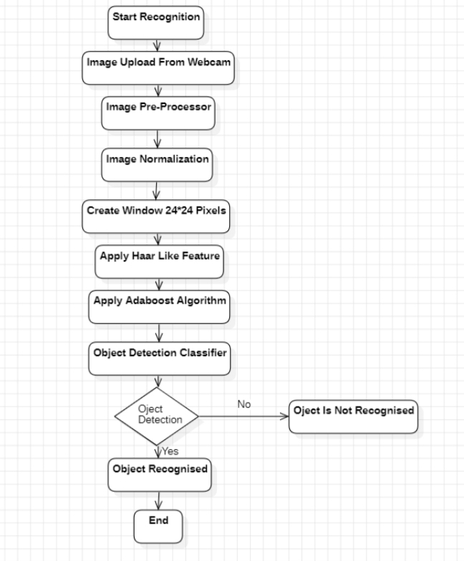
Proposed Methodology

Slide 5
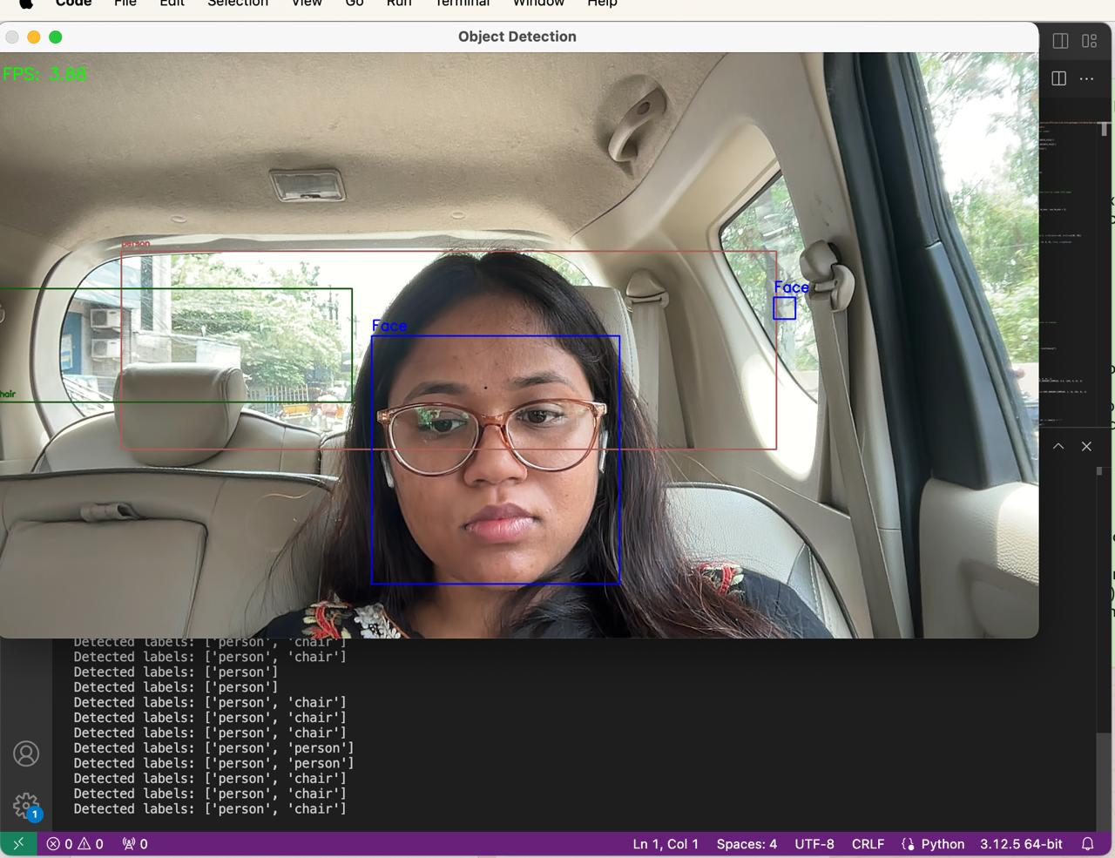
Input Image

Slide 6

Output

Slide 7
Conclusion
The 3D object recognition project effectively combines Python, OpenCV, and machine learning to deliver real-time object detection and notifications. The system processes visual data instantly, accurately identifies objects, and manages data efficiently. It also integrates WhatsApp notifications to keep users informed about detected objects. This comprehensive approach ensures a powerful and responsive solution for advanced object recognition needs, enhancing both functionality and user experience. Future developments could further refine accuracy and expand functionality to meet evolving requirements.

Slide 8
Future Scope
Enhanced Accuracy: Incorporate more advanced algorithms and larger datasets to improve object recognition precision and reduce errors.
Expanded Functionality: Integrate additional features such as multi-object tracking and interaction analysis for more comprehensive insights.
Security Expansion: Can be connected to CCTV cameras , for getting alerts on messages as security alerts

Slide 9
References
Redmon, J., & Farhadi, A. (2018). YOLOv3: An Incremental Improvement. arXiv preprint arXiv:1804.02767. This paper introduces an updated version of the popular object detection algorithm YOLO (You Only Look Once) and discusses the model's architecture, implementation details.
Lin, T.-Y., Dollár, P., Girshick, R., He, K., Hariharan, B., & Belongie, S. (2017). Feature Pyramid Networks for Object Detection. In CVPR, 936-944. This paper presents FPN, a method that improves object detection by building a multi-scale feature representation from deep convolutional neural networks.
Ren, S., He, K., Girshick, R., & Sun, J. (2015). Faster R-CNN: Towards Real-Time Object Detection with Region Proposal Networks. In NIPS (pp. 91-99). This paper introduces Faster R-CNN, which significantly accelerates object detection by integrating Region Proposal Networks (RPN).

